Slide 1
AFRICAN RURAL UNIVERSITY
For Human Development

Slide 2
WELCOME TO THE ARU BRAND GUIDE
Welcome to the Brand Book of African Rural University (ARU). The fact that you are reading this probably means that you want to understand how to tell the story of African Rural University. To find our voice, our true colours, our compass. To create consistency in the representation of ARU, and strengthen brand presence.
How to use this brand guide? When you are creating content for ARU, this guide will give you directions on how to communicate by ARU’s recognisable brand. So whether you are working on the website, creating flyers, newsletters, banners, or other marketing material, this guide will give you directions. It will help you understand what ARU is all about. It will tell you what colour codes to use and how to use them. It will tell you what tone to use while writing. It will tell you what fonts to use, and what type of pictures to take or look for. Read along!
This guide is developed by ARU - specifically representatives of the communication and marketing department and the Resource Mobilisation Board - in partnership with Moonatic Agency and Mustardseed Trust.

Slide 3
01 BACKGROUND
01.1 OBJECTIVES 01.2 SCOPE OF THE PROJECT 01.3 CRITERIA FOR SELECTION
02 INTERVENTIONS 02.1 RESULTS 02.2 CHALLENGES 02.3 LESSONS 02.4 NEXT STEPS
CONTENTS

Slide 4
01 ARU inside out
01.1 Building Blocks 01.2 Brand Story 01.3 Audiences
02 Brand Identity 02.1 Brand Personality 02.2 Our Logo 02.3 Colour Palette 02.4 Typography 02.5 Our Voice 02.6 Imagery
CONTENTS

Slide 5
ARU INSIDE OUT
01

Slide 6
Brand Identity
BUILDING
BLOCKS

Slide 7
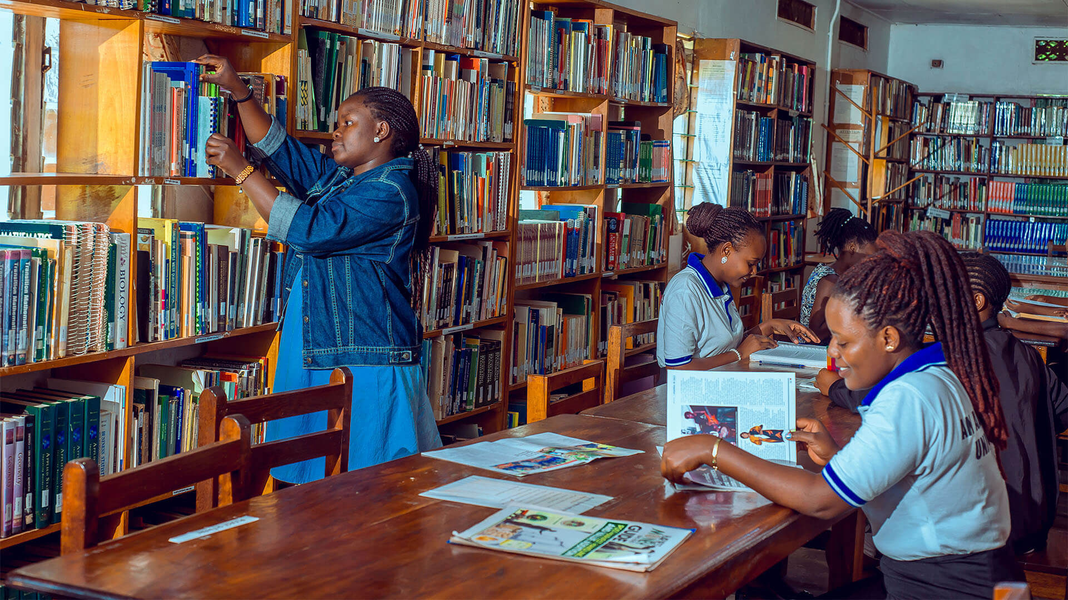
WHO ARE WE
African Rural University is a value-based, all-women university that offers a professional and integrated programme, uniquely merging indigenous knowledge with the disciplines of science, humanities, and arts. Our students graduate as rural transformation specialists. This means that within the African development context, they create conditions for self-reliance, as well as the well-being of local communities and the natural environment.

Slide 8
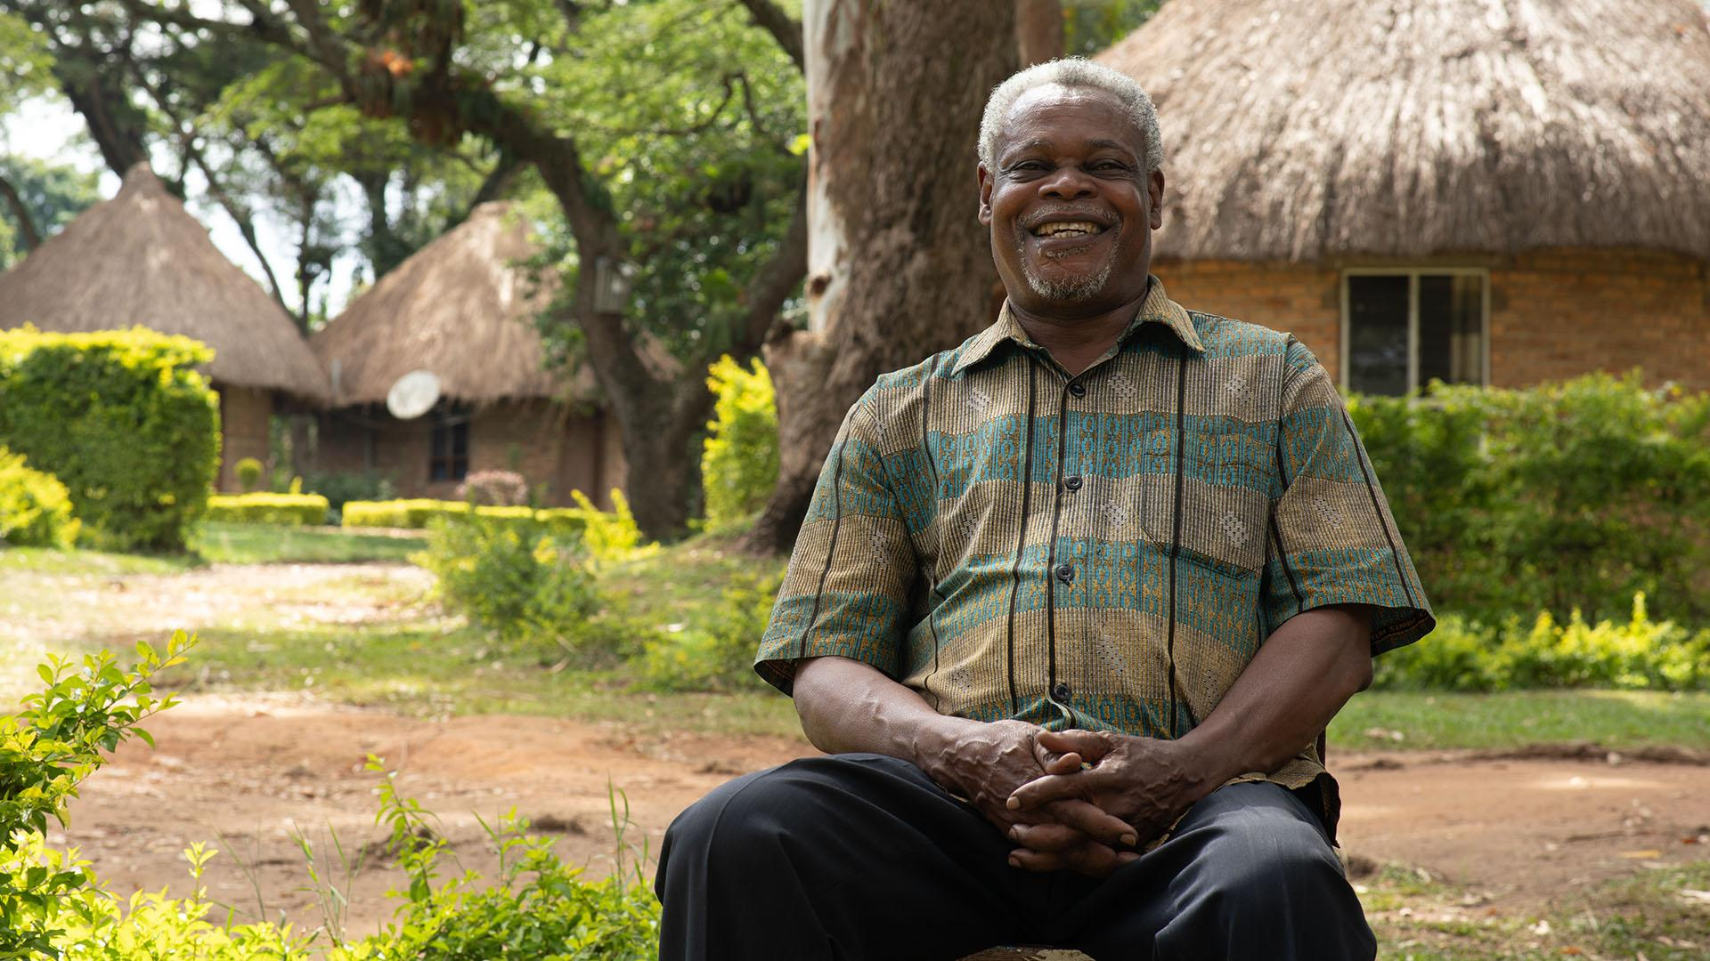

Slide 9
STRATEGY
How do we get there?
01.1 Building blocks | Mission
We facilitate women in rural areas with gaining self-reliance, recognising the inherent power and wisdom of women as educators, managers, peacemakers, counsellors, integrators, and innovators. Our method enables students to learn and develop their innovative visions and skills to bring about transformation in impoverished parts of the world. We know that in order to transform our rural areas, we do not need to look elsewhere: everything we need is right here. We tap into African philosophy and indigenous, traditional wisdom, experience, and resources.
But we always look at the bigger picture. Our approach is holistic and relies on systems thinking. Like an ecosystem, all methods and outcomes are interconnected and interdependent. We combine theoretical learning, innovative instruction and field practice. We blend traditional wisdom, science, humanities, and arts into academic programmes. And we look at development from the perspectives of economy, ecology, social justice, culture and politics

Slide 10
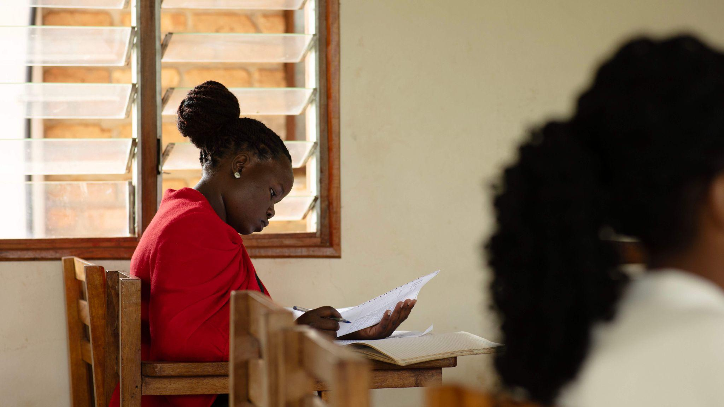
...people are key to their own development. We all have innate power, wisdom and authority, into which we can tap to transform the quality of our lives and our communities.
...lasting change comes only as people shift from reacting or adapting to events and circumstances to being the creators of events and circumstances.
…people who share a common vision can transcend traditional barriers and prejudices caused by tribal, religious, political and gender differences and work together to achieve that which is truly important to them all.
Working Premise
...drawing from the intrinsic attributes of a woman as a teacher, manager, peacemaker, counsellor, integrator and innovator - will benefit both the planet and people.

Slide 11
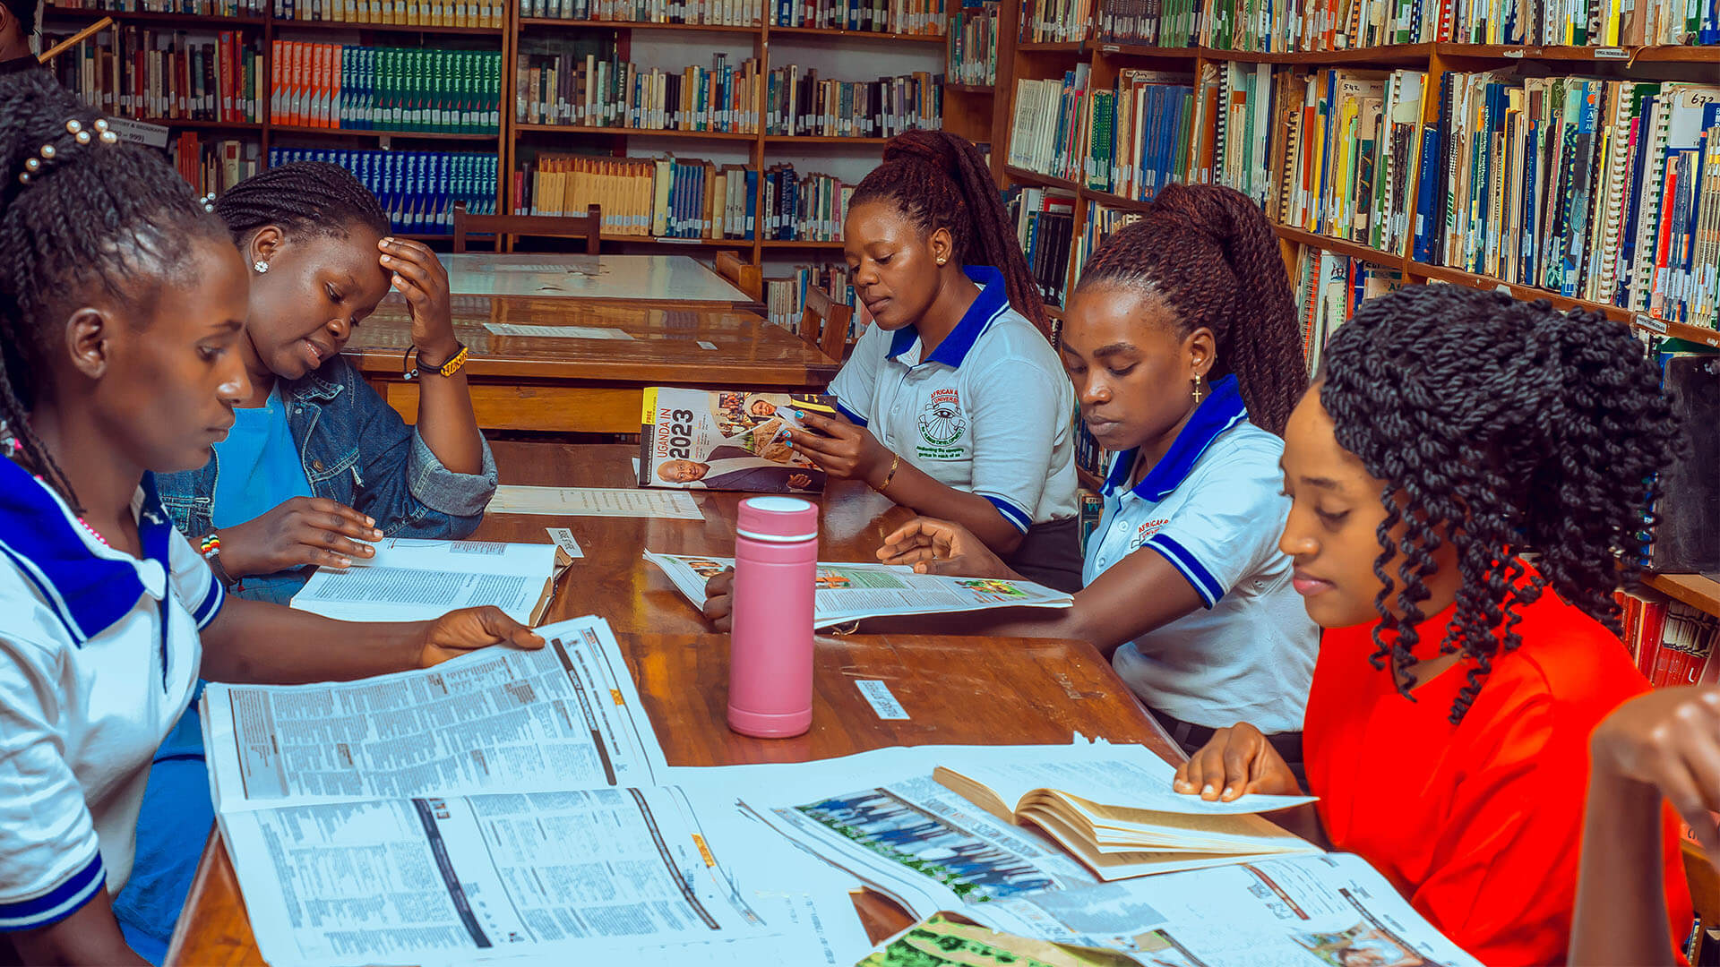
CREDIBILITY
Our impact
The validity and impact of ARU's education model are visible through its graduates.
Economically poor households understand that they are key to their own development. They create partnerships rather than power and control relationships.
Local leaders and their constituencies work around shared visions and action plans.
Graduates create friendships and platforms that consider social justice, cultural heritage, economic-, ecological-, and political forces for joined action around common values and goals.

Slide 12
Brand Identity
BRAND STORY

Slide 13
BRAND STORY
The validity and impact of ARU's education model are visible through our graduates. They use their skills, vision, and knowledge to awaken people’s sleeping genius. Economically poor households understand that they are key to their own development. Local leaders and their constituencies work around shared visions, values, and action plans. Our graduates create partnerships rather than relationships built through power and control. They create friendships and platforms that consider economic, ecological, social justice, cultural heritage, and political forces for joint action around common values and goals.
Join us on this journey to create thriving, rural economies based on care for self, others, and mother earth. Together, we can foster a world of freedom, peace, health, happiness, and prosperity for all.
Amidst Uganda’s green landscapes rises the all-women African Rural University (ARU). ARU recognizes the inherent power and wisdom of women as educators, managers, peacemakers, counsellors, integrators, and innovators. With professional, visionary women in the lead, ARU catalyses systems change for sustainable development in rural communities.
ARU offers a holistic approach to education. We blend traditional wisdom, science, humanities, and arts into academic programmes that skill women to enable transformative processes for rural communities. This makes communities thrive while nurturing their natural environment.
01.2 Brand Story | Credibility

Slide 14
Brand Identity
AUDIENCES

Slide 15
SUPPLY AUDIENCE
Funders and investors
Shared vision. Alignment of values is key to partnerships. They need to recognise and identify with ARU’s vision.
Impact. While the interest in ecological, economic or social impact may vary, the fact that ARU makes a difference is key to this audience.
Credibility. The audience needs to trust the professionality of the institution. They value demonstrable experience, achieved results, and certification.
Facts. Although an emotional and personal bond with the organisation is an important starting point, they value straightforward, transparent, and clear communication.
What characterises this audience?
This international audience has a wide range of characteristics, backgrounds, and specific interests. However, there are a few things that are important to this audience, no matter where they are from.
01.3 Audiences| Supply Audience

Slide 16
SUPPLY AUDIENCE
Funders and investors
Personal contact. Personal and direct contact is very important to this audience. Communication often takes place in a personal manner. The people behind the organisation (for example the VC, the University Secretary, or council members) are of great importance to this audience. Therefore the personal relationship between ARU and this audience is more important than the branding itself.
How does this audience interact with the ARU brand?
01.3 Audiences| Supply Audience

Slide 17
DEMAND AUDIENCE
Students and communities
Accessibility. It’s important for this audience to feel like the ARU is accessible to them, both in terms of finance, social structure, and education level.
Employment opportunities. As this audience has desires for sustaining jobs, the 100% employment rate is a key element.
Mentorship. This audience is looking for an institution to lead the way, pave the road, and provide them with the tools and knowledge that they need.
Trustworthiness. It’s important for this audience to know that the organisation is reliable and keeps its promises.
What characterises this audience?
This audience exists mostly of young females in rural areas of Uganda. They are ambitious and desire purposeful jobs that can sustain them and their families.
01.3 Audiences| Demand Audience

Slide 18
DEMAND AUDIENCE
Students and communities
Identification. When the audience sees the brand of ARU, they identify with it. Potential students feel like the ARU is the right fit for them. Enrolled students feel like the ARU represents them - and the other way around. They are proud to be part of the organisation.
Role model. While ARU is accessible to this audience, at the same time a sense of prestige is important to increase credibility. While the students build leadership based on their own vision, ARU is still their mentor and teacher - giving direction in where and how to go about.
How does this audience interact with the ARU brand?
01.3 Audiences| Demand Audience

Slide 19
BRAND
IDENTITY
02

Slide 20
Brand Identity
BRAND PERSONALITY

Slide 21
02.1 Brand Personality | Core Themes

Slide 22
ARU
Characteristics
Rural.
African.
All-women.
02.1 Brand Personality | ARU Characteristics

Slide 23
ARU
Personality Traits
Accessible. Positive.
Creative. Visionary. Transformative.
Different. Confident. Activating.
Hands-on-Learners by Doing
02.1 Brand Personality | Personality Traits

Slide 24
Brand Identity
OUR LOGO

Slide 25
The logo represents the story of ARU that is reflected in the motto: awakening the sleeping genius in each of us. The eye is open; as if just waking up. The rays below the eye represent the vision of the awakened person. A vision that is built around human development in rural areas
02.2 Logo

Slide 26
LOGO
USAGE
It is important to use a logo in a way that is consistent with its design and purpose.
Some ways in which a logo should not be used. Therefore:
Don't distort the logo: A logo should never be stretched or compressed disproportionately as this can change the shape and proportions, making it difficult to recognize and reducing its effectiveness.
Don't use the wrong colours: A logo should always be used in its original colours. Using incorrect colours can change the meaning or impact of the logo and can also weaken brand recognition.
When using the full logo, the colors are divided over the titles and motto. When using the logo without motto, the word ‘university’ needs to be blue to make sure all colors are used in the logo.
Don't use low-quality versions: Using a low-quality or pixelated version of a logo can make it appear unprofessional and unappealing, reducing its effectiveness and impact.
Leave enough space around the logo: The logo should be given enough space and room to breathe. Overcrowding it with other elements or text can make it difficult to recognize.
02.2 Logo

Slide 27
LOGO USAGE
Full color
20% Opacity
Full white (coloured background)
02.2 Logo
Do not distort
Do not distort
Do not rotate

Slide 28
LOGO & AVATAR
The icon is a symbol of a brand logo, used when a full logo won't fit. The icon is the main focal point of ARU’s logo.
The avatar version of the logo is mainly used for social media.
02.2 Logo

Slide 29
Brand Identity
COLOUR PALETTE

Slide 30
COLOUR PALETTE
MAIN COLORS
NEUTRAL COLOUR
02.3 Colour Palette
#FFFFFF RGB (255, 255, 255)
#249428 RGB (36, 148, 40)
#1d5d8d RGB (29, 93, 141)
#ef2e39 RBG (239, 46, 57)

Slide 31
COLOUR PALETTE
MAIN COLORS
Green symbolize the ARU’s focus on agriculture, nature, and sustainability. Green is commonly associated with growth, freshness, and harmony with the environment. It represents the university's commitment to agricultural education, research, and practices that promote ecological balance and sustainable farming.
Including blue in the branding can emphasize the scientific and technological aspects of agriculture. Blue is often associated with trust, knowledge, and professionalism. It conveys a sense of reliability and expertise, which aligns with the university's role in providing quality education and research in agricultural sciences.
Red adds a touch of vibrancy and energy. Red is a color that grabs attention and symbolizes passion, strength, and dynamism. It represent the university's drive to excel in agricultural education, research, and innovation.
Red also evokes a sense of urgency and action, highlighting ARU's commitment to addressing the pressing challenges and opportunities in the agricultural sector. Additionally, red evokes a feeling of community and excitement, fostering a sense of belonging and enthusiasm among students, faculty, and staff.
02.3 Colour Palette

Slide 32
Brand Identity
TYPOGRAPHY

Slide 33
HEADER
& TITLE FONT
ABCDEFGHIJKLMNOPQRSTUVWXYZ
1234567890!@#$%^&*()?
abcdefghijklmnopqrstuvw
Lora is an elegant and legible serif font that works well for headings and titles. Its classic design and moderate contrast give it a timeless and sophisticated appearance.
Lora's versatility allows it to work effectively in both digital and print contexts. It pairs nicely with Roboto (our plain text font), as the contrast between a sans-serif font like Roboto and a serif font like Lora creates a visually appealing and balanced typographic hierarchy.
When using Lora for titles, you can consider adjusting the font weight or size to create distinction and hierarchy between different heading levels, ensuring a clear and organized visual structure.
Download Font Lora
02.4 Typography
Aa Aa

Slide 34
PLAIN TEXT & SUBHEAD FONT
ABCDEFGHIJKLMNOPQRSTUVWXYZ
1234567890!@#$%^&*()?
abcdefghijklmnopqrstuvw
Roboto was selected due to its exceptional readability, making it easy for users to absorb information effortlessly. With a balanced and clean letterform, it ensures clarity and reduces eyestrain, particularly when reading content on digital screens.
Moreover, Roboto's neutral and modern aesthetic aligns well with ARU's brand image, projecting a professional and approachable vibe.
ABCDEFGHIJKLMNOPQRSTUVWXYZ
1234567890!@#$%^&*()?
abcdefghijklmnopqrstuvw
02.4 Typography
Download Font Roboto
Aa Aa

Slide 35
Brand Identity
OUR VOICE

Slide 36
SERIOUS VS FUNNY
ARU’s tone of voice is neither very serious nor very funny. In a rather neutral way, we state things as they are and the future as it will be. At ARU, we don’t joke around, yet don’t take ourselves too seriously. We just are who we are.
Serious
Funny
The 4 scales and
tone indicators
INFORMATIVE
02.5 Voice
FORMAL VS CASUAL
ARU’s tone is informal yet professional. It is easy to understand, not too complex. No long sentences or difficult words. It’s accessible for a wide range of people, but doesn’t go colloquial.
Formal
Casual
FRIENDLY PROFESSIONAL

Slide 37
RESPECTFUL VS IRREVERENT
ARU’s tone is respectful, as they are not trying to rebel or be an activist. They are mentors, they are listeners, they are present. They focus on the future, the possibilities, and the collaboration that is needed to build it: together.
Respectful
Irreverent
The 4 scales and
tone indicators
SOLUTION-FOCUSED COLLABORATION
02.5 Voice
MATTER-OF-FACT VS ENTHUSIASTIC
ARU’s tone is positive, activating and confident. They trust in their model and are excited to share them with the world. However, ARU keeps their calm. The tone of voice does not get too upbeat and cheerful, they stay somehow down to earth.
Matter-of-fact
Enthusiastic
PASSIONATE POSITIVE

Slide 38
LANGUAGE USAGE
Correct: colour, flavour, labour
Incorrect: color, flavor, labor
Correct: organise, analyse
Incorrect: organize, analyze
Correct: travelling
Incorrect: traveling
We use British English, as this is more commonly used on the African continent.
02.5 Language Usage
One - ten are written in words → nine instead of 9
All above are written as numbers → 23 instead of twentythree
pm/am in English copy → 5pm
24-hour clock in Dutch copy → 17:00
Month: fully written → November
Day of the month: numbers → 5th November
Years: numbers → 5th November 2022

Slide 39
LANGUAGE USAGE
Active voice instead of
passive voice.
Correct: Joseph made a hilarious joke at the network event.
Incorrect: A hilarious joke was made by Joseph at the network event.
Correct: Rose will bake one hundred cupcakes for the upcoming company outing.
Incorrect: One hundred cupcakes will be baked by Rose for the upcoming company outing.
02.5 Language Usage

Slide 40
LANGUAGE USAGE
Titles: use punctuation marks only in head titles that are a phrase (not a name or one-word titles), or in subtitles.
Lists and bullet points: use punctuation marks when using sentences or phrases.
In more formal documents, use ; at the end of (bullet) point.
Only use abbreviations when this is the common way of using a term - and when the context allows using this abbreviation.
Lists, titles, punctuation, and abbreviations.
02.5 Language Usage

Slide 41
Brand Identity
IMAGERY

Slide 42
STYLE
As ARU, we capture the essence of nature and collaboration in imagery. It should convey happiness, confidence and healthy people. Using bright colours, natural landscapes, technology and images of people. You can search for suitable images or videos in our archive, or shoot footage yourself.
While taking or choosing footage, try to show one or multiple of the following:
Natural Landscapes: Include imagery of lush green fields, farms, and agricultural landscapes to emphasize the connection with nature and the rural environment. Even better if the image shows people interacting with nature!
Collaboration: Depict imagery of people working together in teams, whether in the fields, classrooms, or research labs.
Showcase the spirit of cooperation, knowledge sharing,
Happiness and Confidence: Showcase individuals and groups of people smiling, engaged in their work, and demonstrating confidence in their abilities.
Healthy People: Showcase healthy individuals engaged in physical activities, such as farming, exercising, or participating in outdoor sports. Emphasize the importance of a healthy lifestyle and the positive impact of agriculture on people's well-being.
Bright Colors: Incorporate vibrant and lively colors in the imagery to create a visually appealing and energetic atmosphere. Use colors that are commonly associated with nature, such as various shades of green, blue, and earthy tones.
Technology: Integrate technology in the imagery, to highlight the innovative and technologically advanced approach of ARU towards agricultural practices. Think of computers, laptops, iPads, or agricultural technology - and students who use them!
Local Culture: Incorporate elements of Ugandan culture and traditions in the imagery to celebrate the university's connection to its local roots. This could include traditional clothing, dances, or cultural events.
Women in the lead: Showcase women - mostly women in leadership roles. Think of women teaching or explaining techniques to others; women giving presentations; women speaking to larger groups of people; confident women.
02.5 Imagery

Slide 43
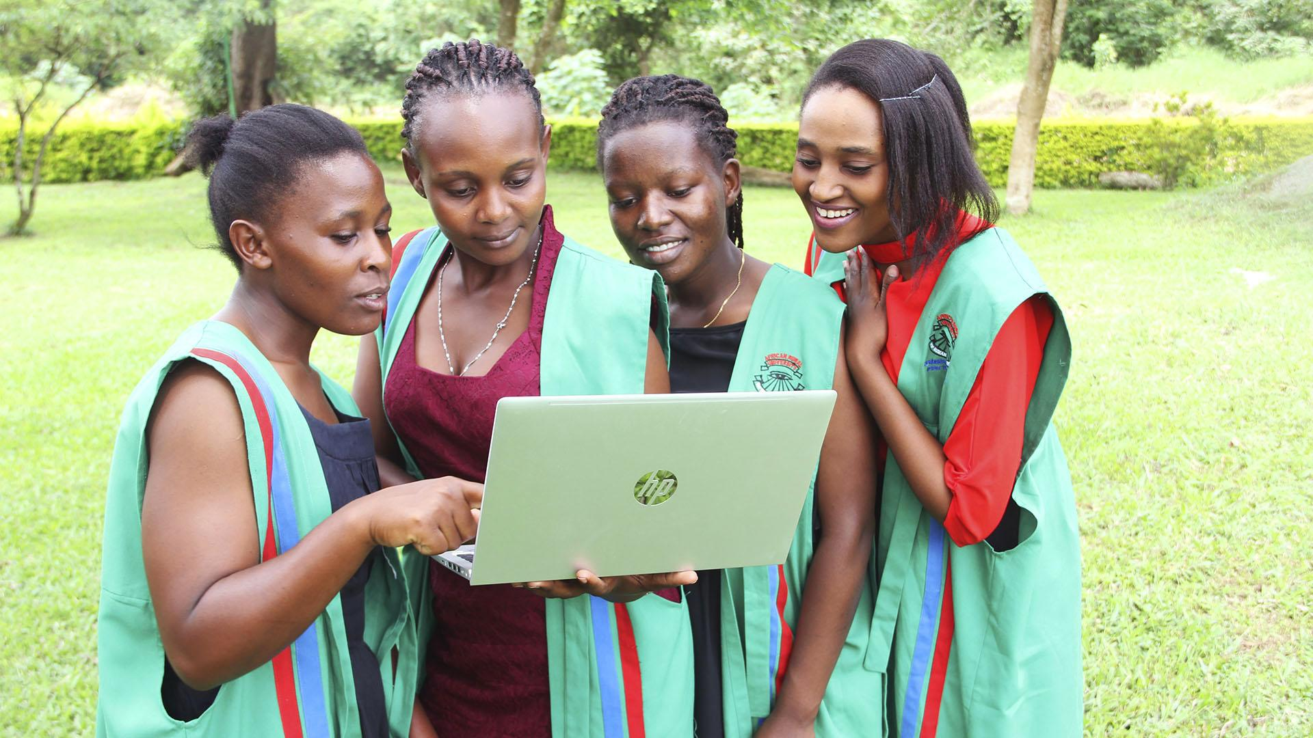
EXAMPLE: HAPPINESS,NATURAL LANDSCAPE, TECH, AND COLLABORATION

Slide 45
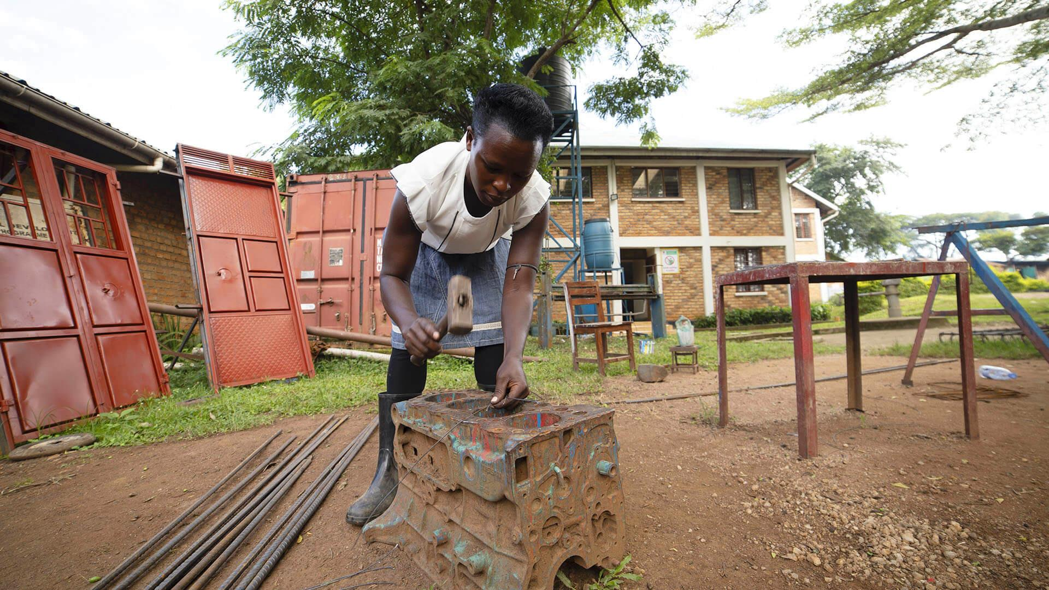
EXAMPLE: WORK ABILITIES

Slide 46
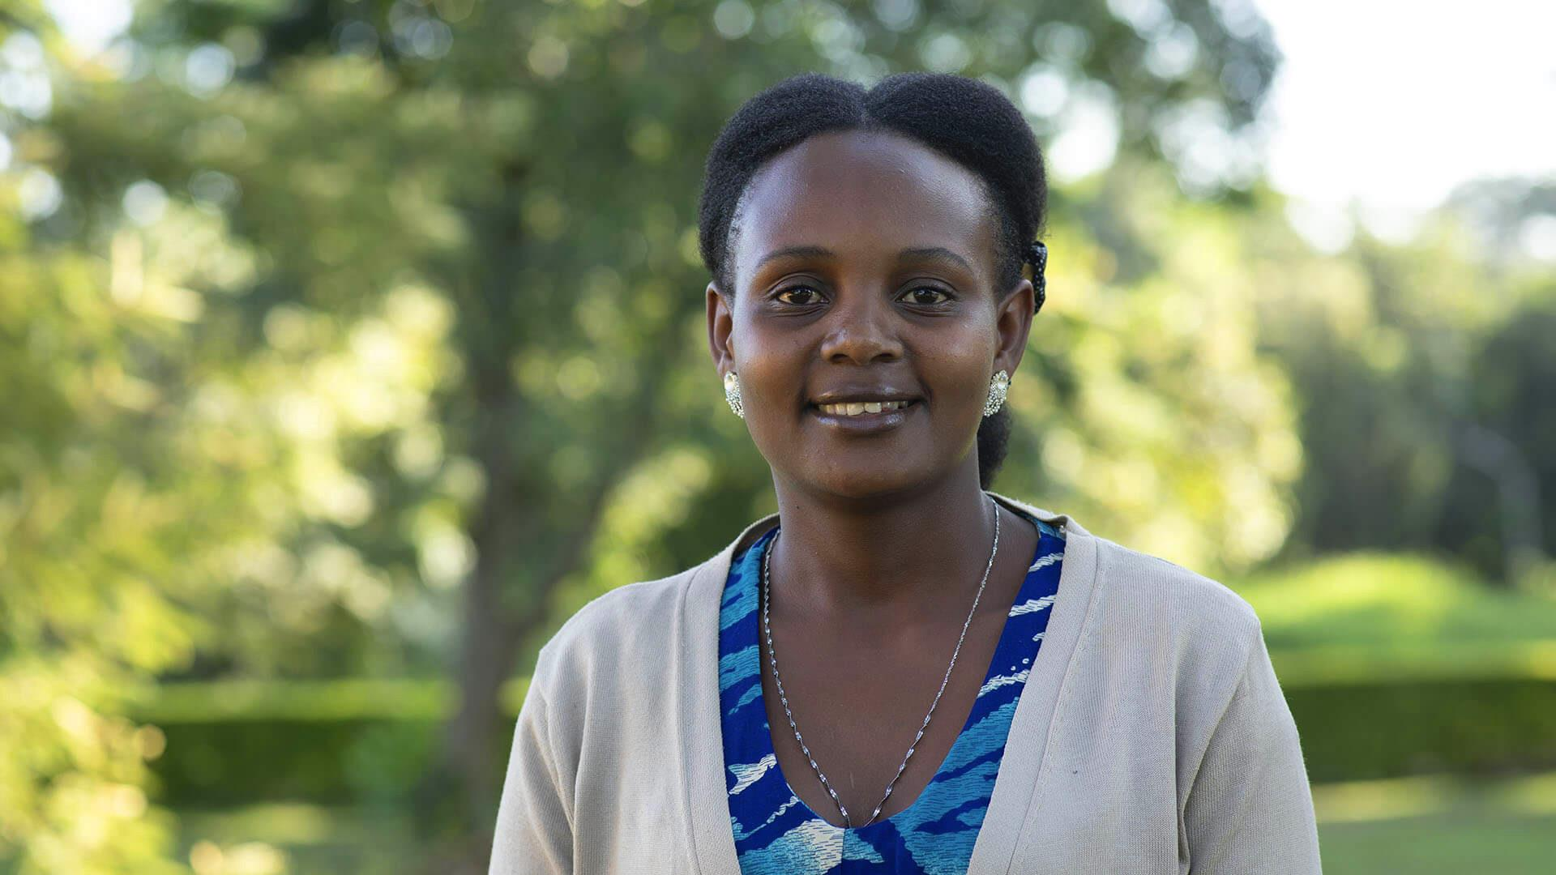

Slide 47
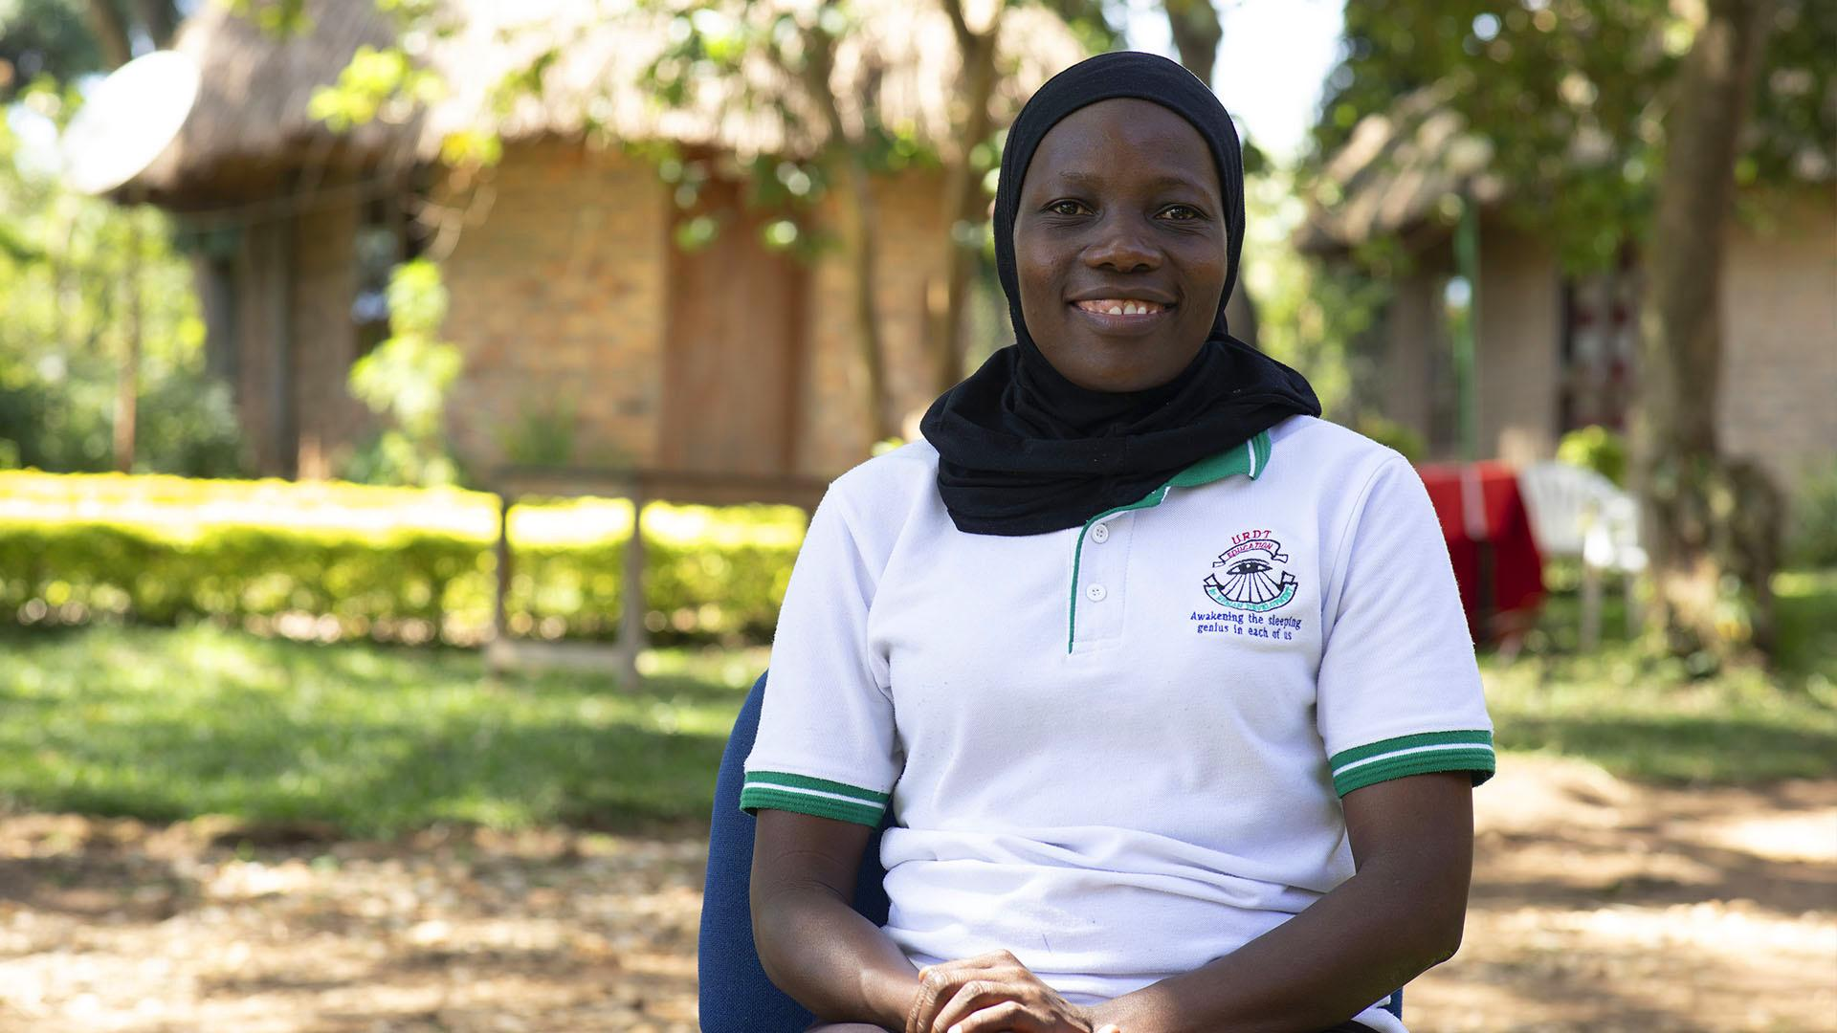

Slide 48
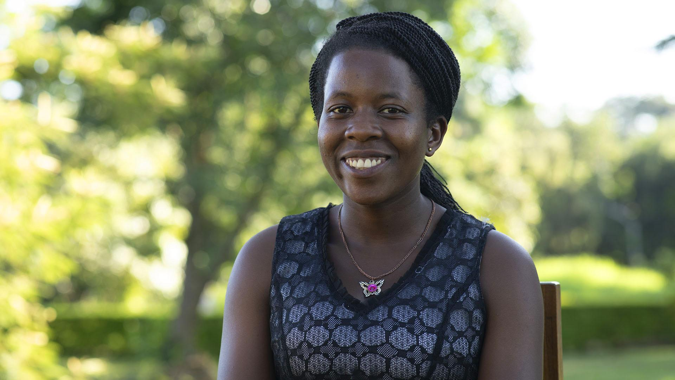
EXAMPLE: HAPPY STUDENTS

Slide 49
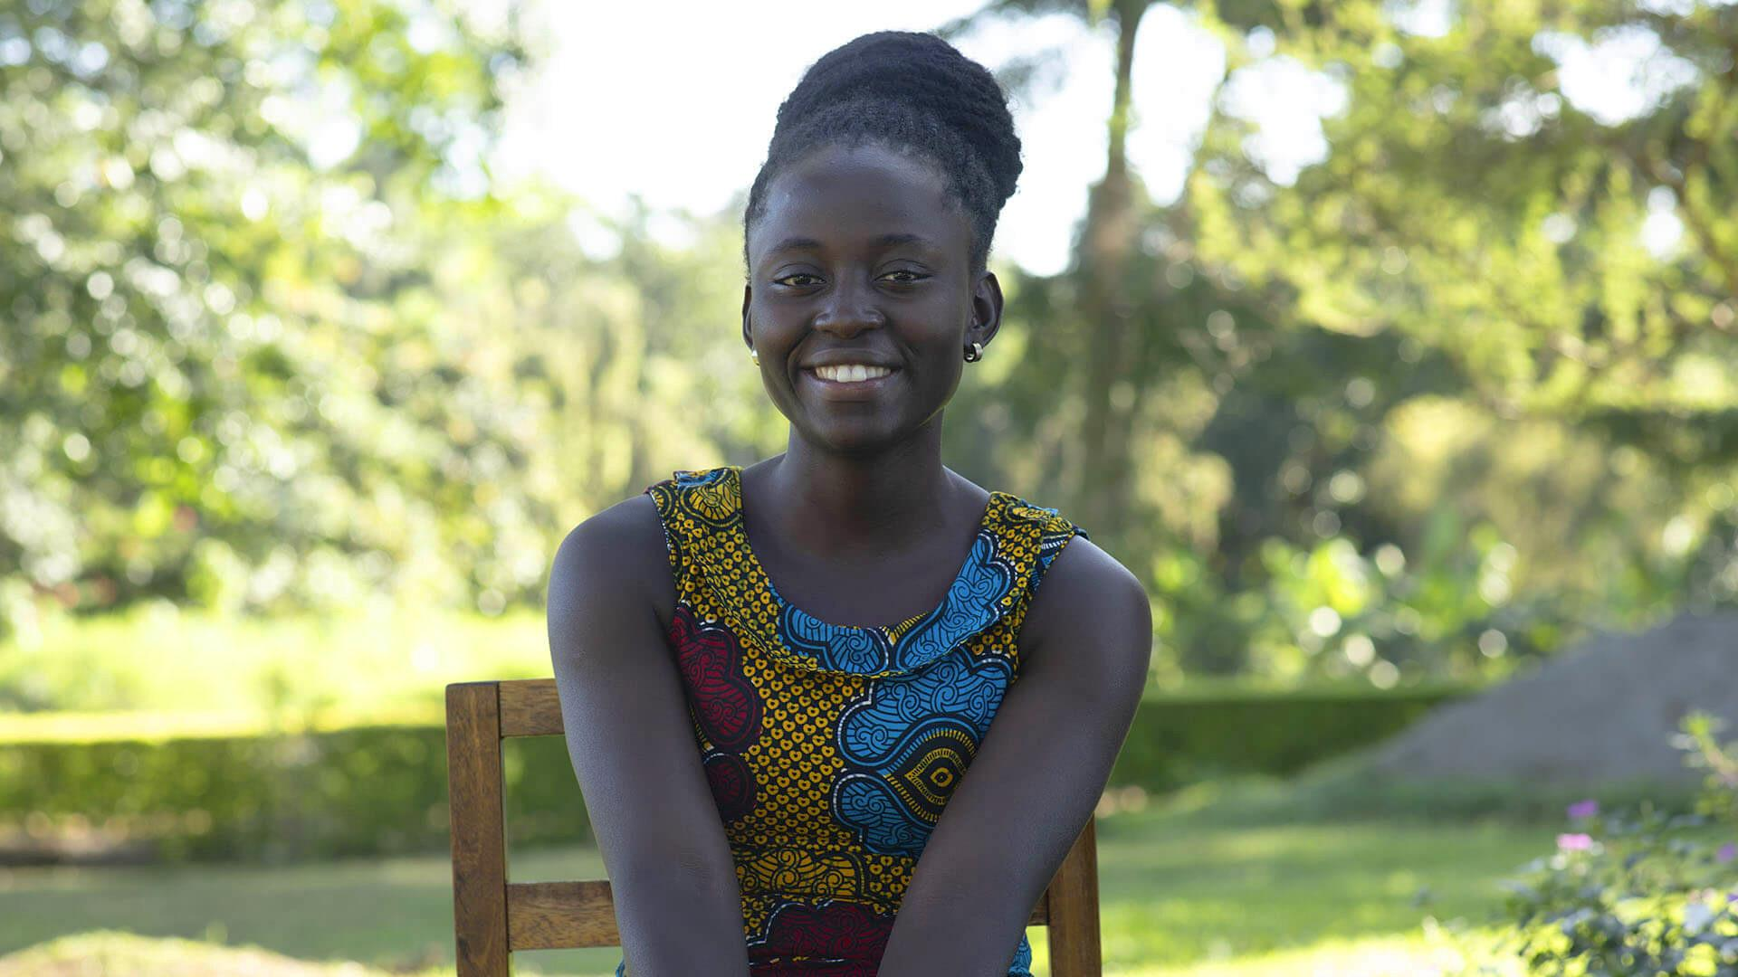

Slide 50
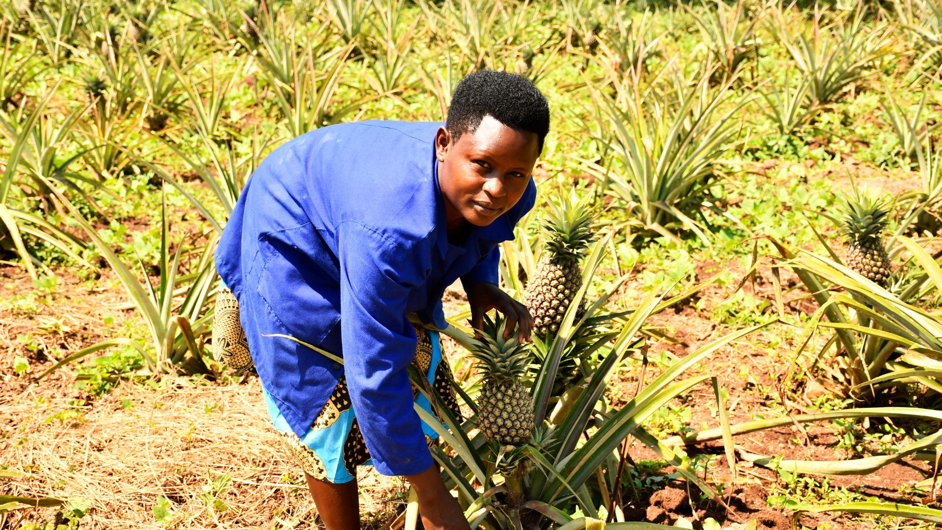
EXAMPLE: RURAL AREA, COMMUNITY, NATURE

Slide 51
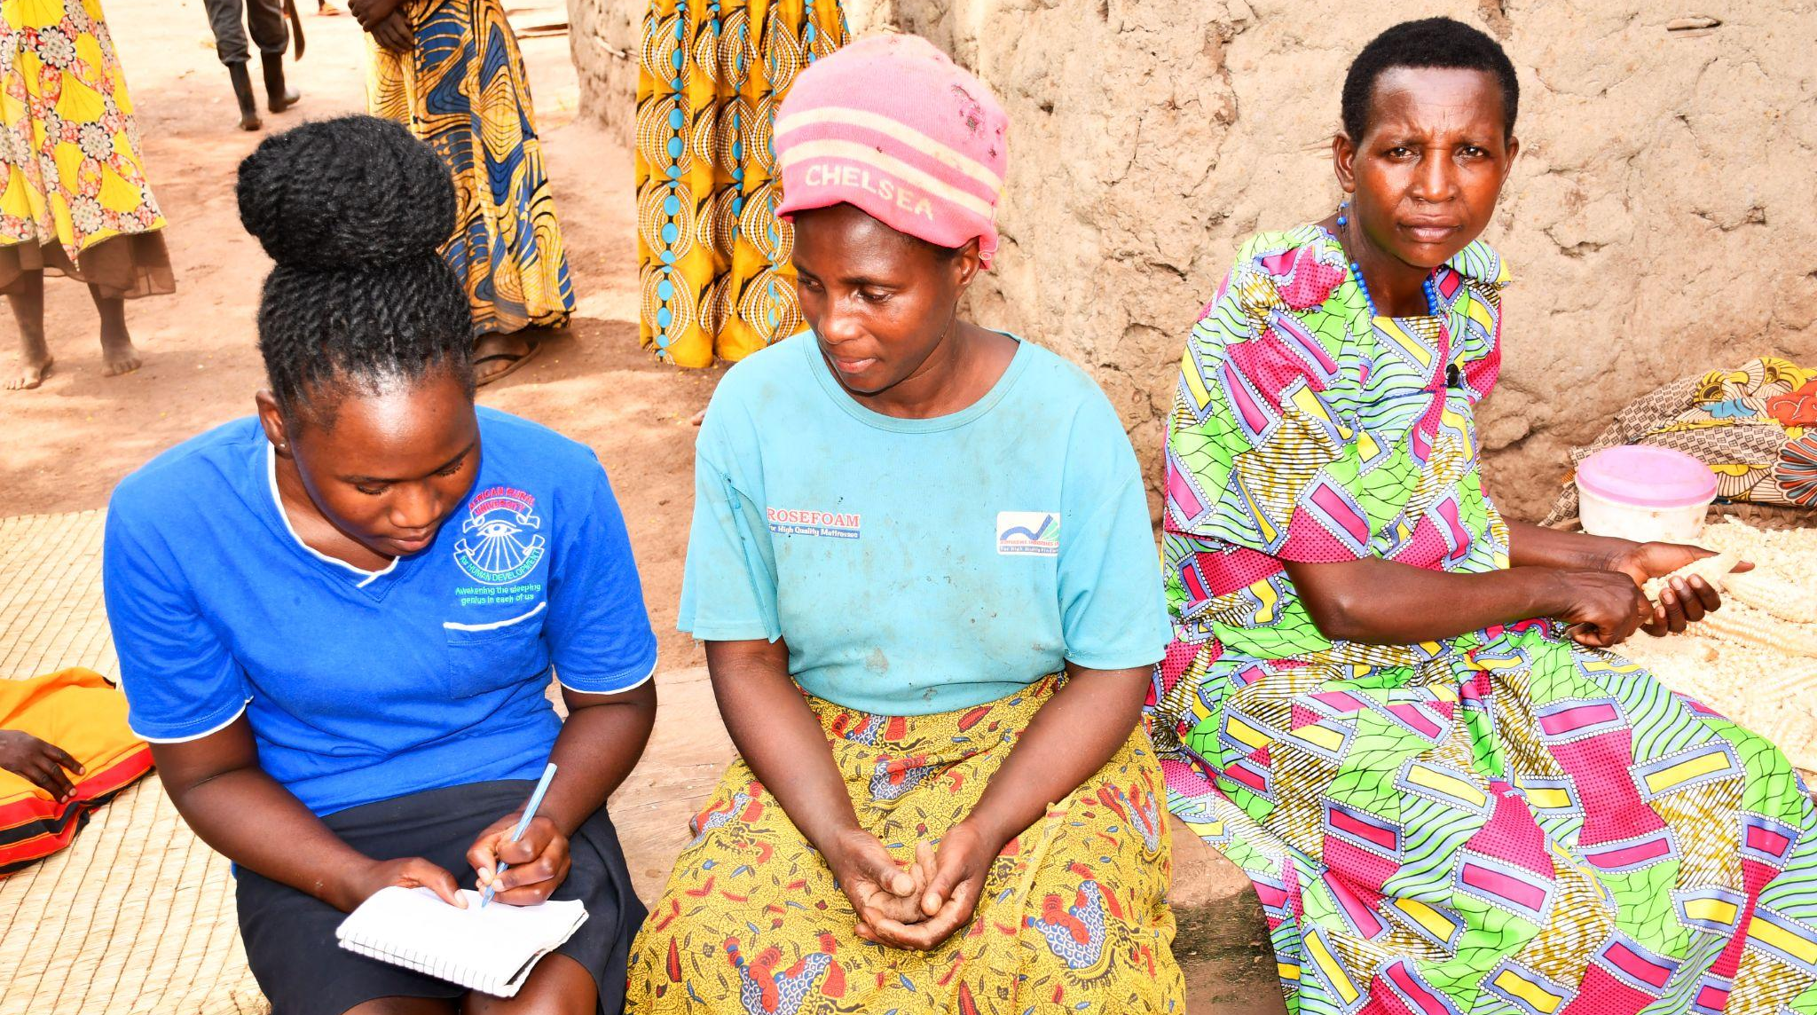
INTERNSHIP

